Slide 1
ReactJS Training
Day 7

Slide 2
Topics
Lists & State
Updating State Immutably
Lists & Keys
Flexible Lists

Slide 3
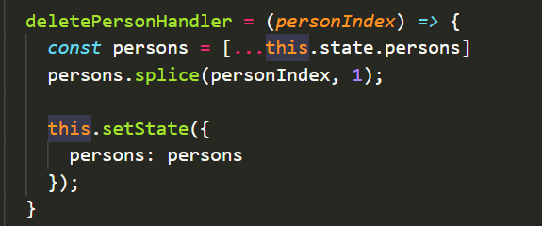
Lists & State
Map method exposes a second argument ,the index in the array.
this.state.persons.map((person,index) => {}
Create a new version of that person's array.
Call person.splice to remove the element.
Set the state of the persons to the new persons, the updated persons

Slide 4
Some Important points
In case if you're wondering how we can edit a constant
Arrays and objects are reference types so I didn't assign a new value to the constant, it is only holding a pointer
We have only changed the element it was pointing to.

Slide 5
Updating State Immutably
You should always update state in an immutable fashion, so without mutating the original state first.
Create a copy, change that and then update the state with said state.
E.g.
1) Slice method : const persons = this.state.persons.slice();
2) Spread Operator : const persons = [...this.state.persons]

Slide 6
Lists & Keys
The key prop is actually an important property we should add when rendering lists of data.
Key property helps react update the list efficiently.
With key property, React re-renders the elements which did change and not the whole list.
Syntax: index is an unique identifier on the list
key={index}
key={person.id}

Slide 7
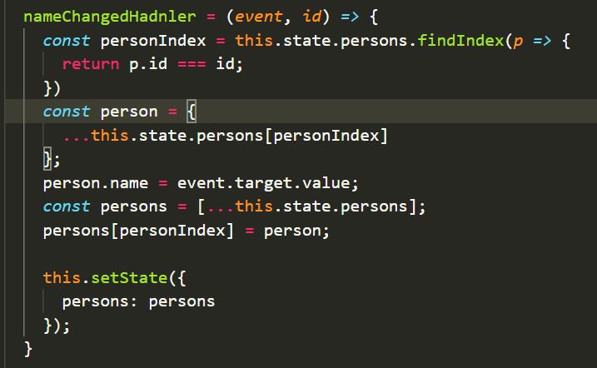
Flexible Lists
FindIndex: returns the index of the first element in the array that satisfies the provided testing function.
Retrieve specific element from array using personIndex and store in it person variable.
Assign the input value to new person.name
Create a new copy of original persons array.
Update the persons value at specific index(personIndex) with new person.
Update the state with updated persons.

Slide 8


